Slide 1
Evolutionary Algorithm framework for Controlling Strategies of a Batbot
Midterm presentation
Anuar Santoyo alum 安武 2022280136
Supervisor: Prof. ZHAN YUN张云
2024/01/19

Slide 2
TABLE OF CONTENT
Static test-bench
Optimizer
Force Analysis
Dynamic test-bench
New Batbot Version
Final Stage

Slide 3
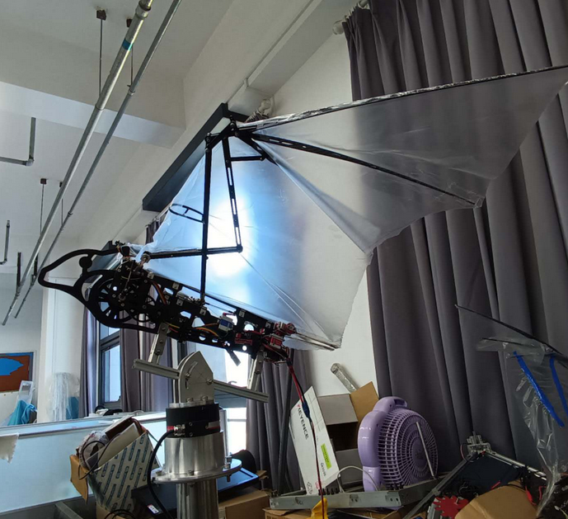
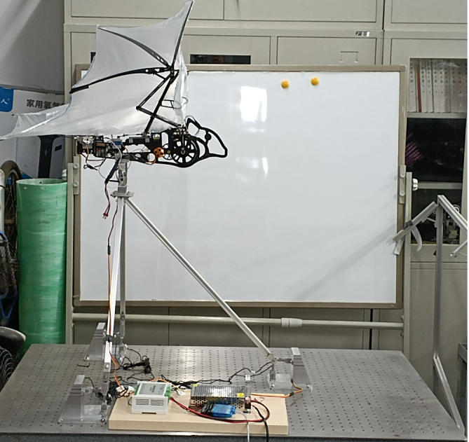
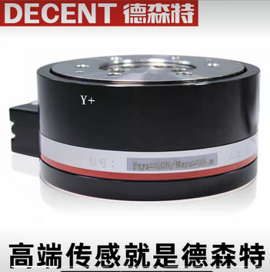
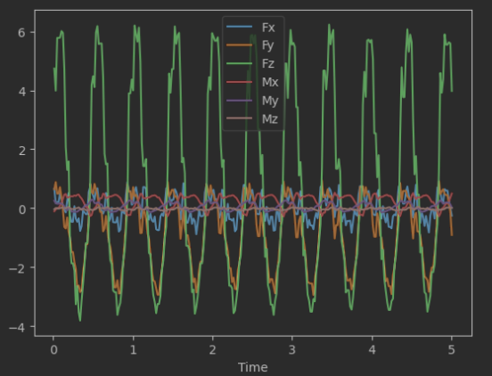
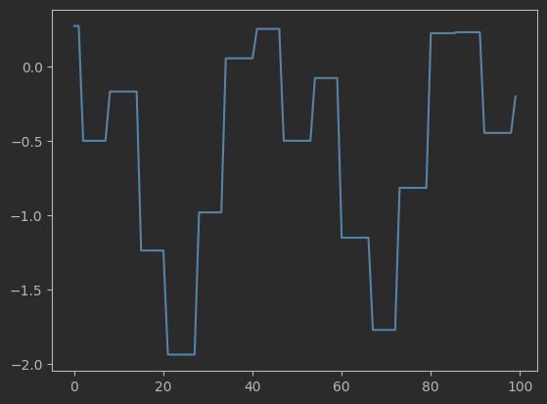
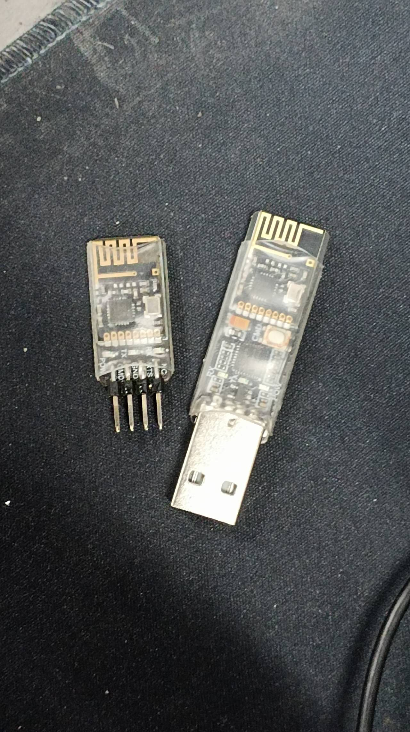
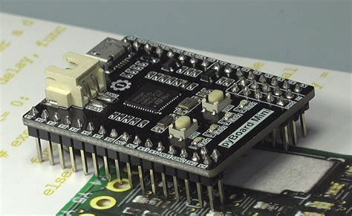
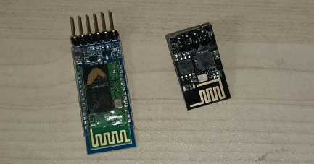
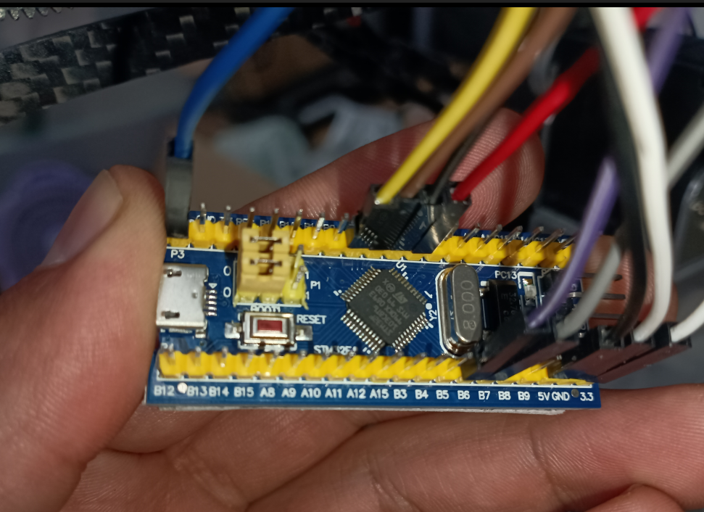
Static Test-bench
Difficulties and Solutions:
Microprocessor:
STM32 (C++)
PyBoard (Micro Python)
Communication:
Bluetooth, ESP8266 (Wifi)
Wireless UART
Sensors:
Load Sensors (DAQ BSQ-JN-P8)
6 Axis Sensor
Page 1

Slide 4
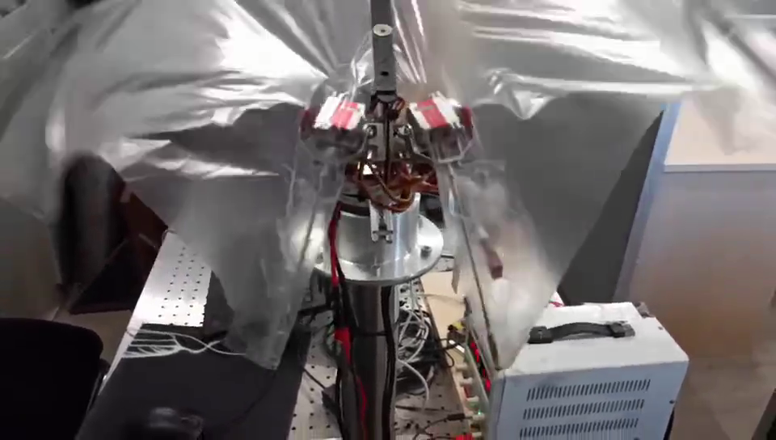
Optimizer - EA to find controlling method
Main Idea: Find the best movement of the hind-legs to reduce force in vertical direction.
Page 2

Slide 5
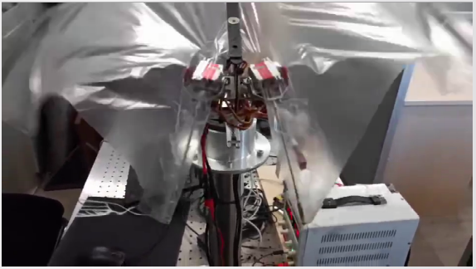


Optimizer - EA to find controlling method
Main Idea: Find the best movement of the hind-legs to reduce force in vertical direction.
Parameters:
X middle point
Y middle point
X amplitude
Y amplitude
Ellipse shape/direction
(X, Y) mid. point
Page 2

Slide 6
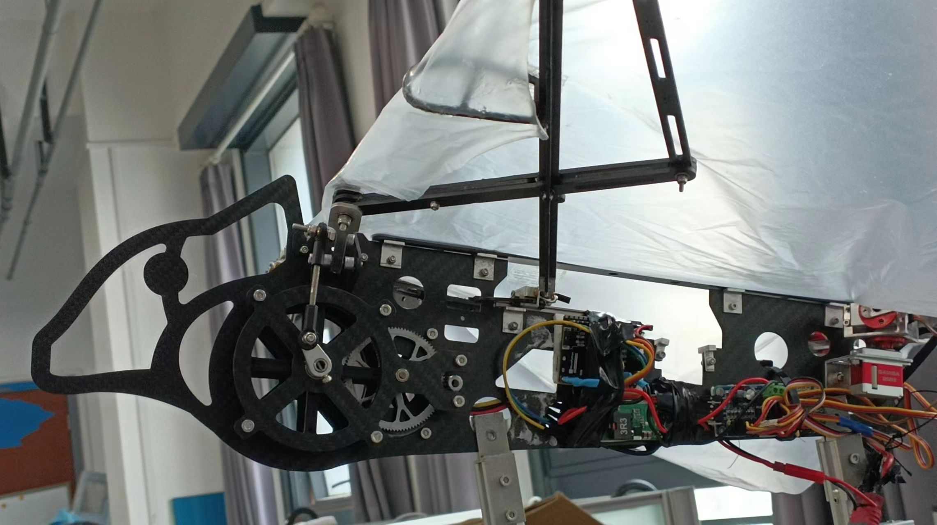


Optimizer - hardware
Batbot with PyBoard (MicroPython)
Wireless UART
6 Axis Measurements
Computer - Python
Measurements ModBus Protocol
Page 3

Slide 7
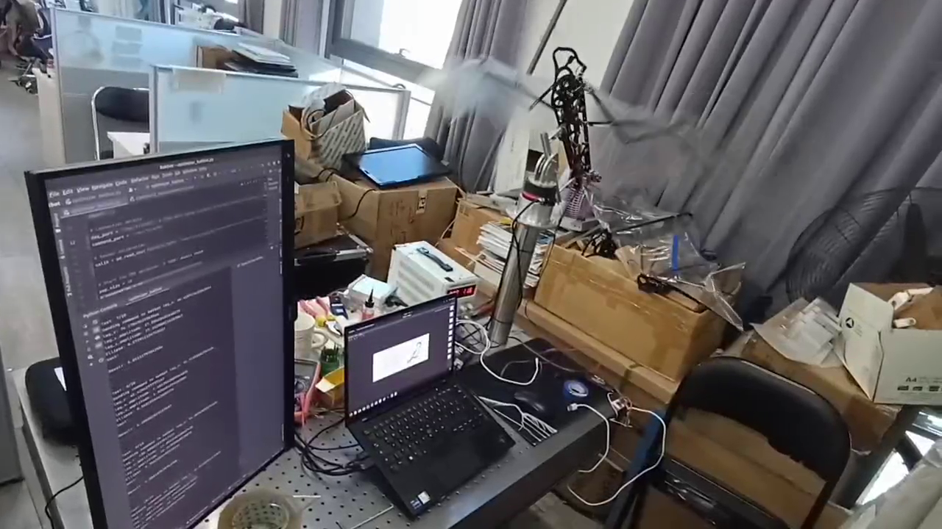
Optimizer
Workflow:
10 possible solutions
Test one by one and calculate score
Based on scores optimize and propose 10 new possible solutions
Repeat until convergence
Page 4

Slide 8
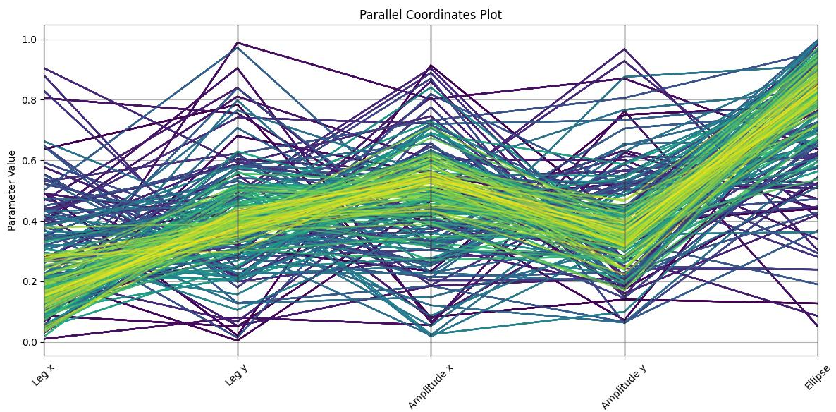
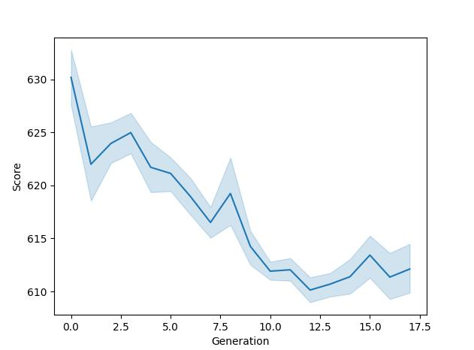
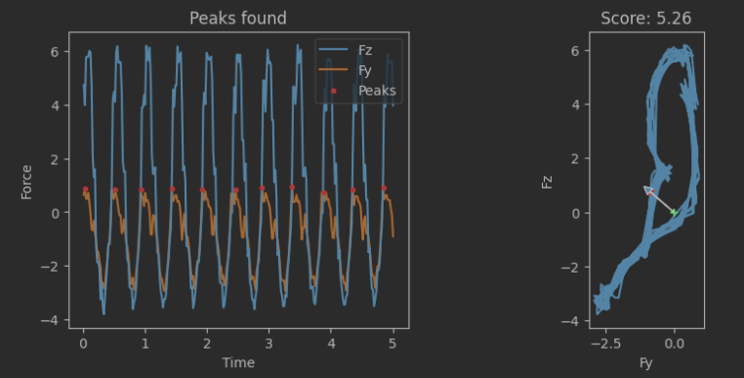
Optimizer
Results:
More accurate score calculation
Working EA optimization
Possible to find optimal solution
Problem:
Optimization stagnates because mechanical limitation
Test Example
Page 5

Slide 9
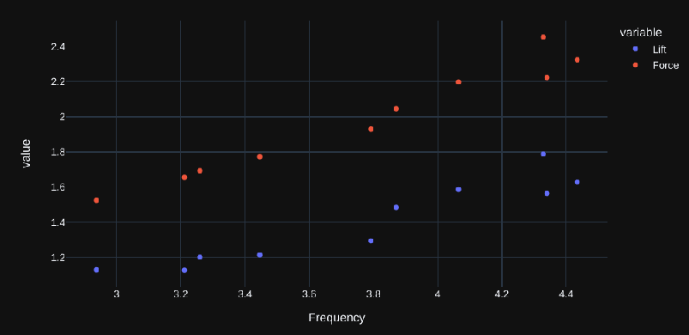
Force Analysis – Frequency vs force
Experiment with increasing power to analyze average lift and resulting average force
Why so far from 6.7N when flying has already been achieved?
Page 6

Slide 10
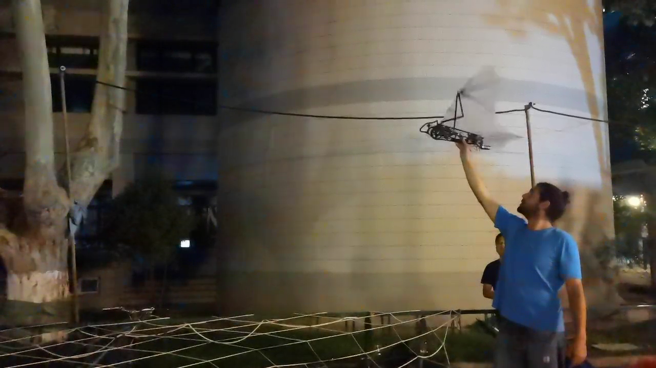
Force Analysis – Frequency vs force
Experiment with increasing power to analyze average lift and resulting average force
Why so low force when flying has already been achieved?
→ wing foil does not generate lift in hovering.
Need to upgrade Batbot to achieve higher forces
Page 7

Slide 11
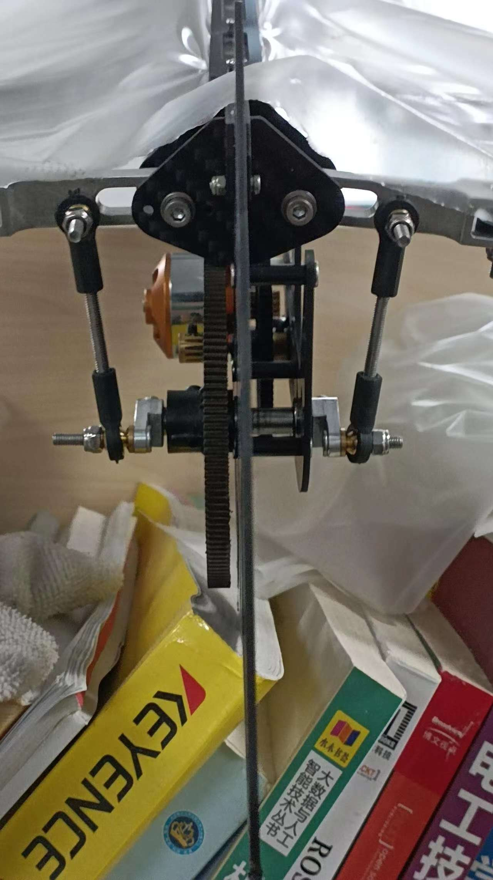
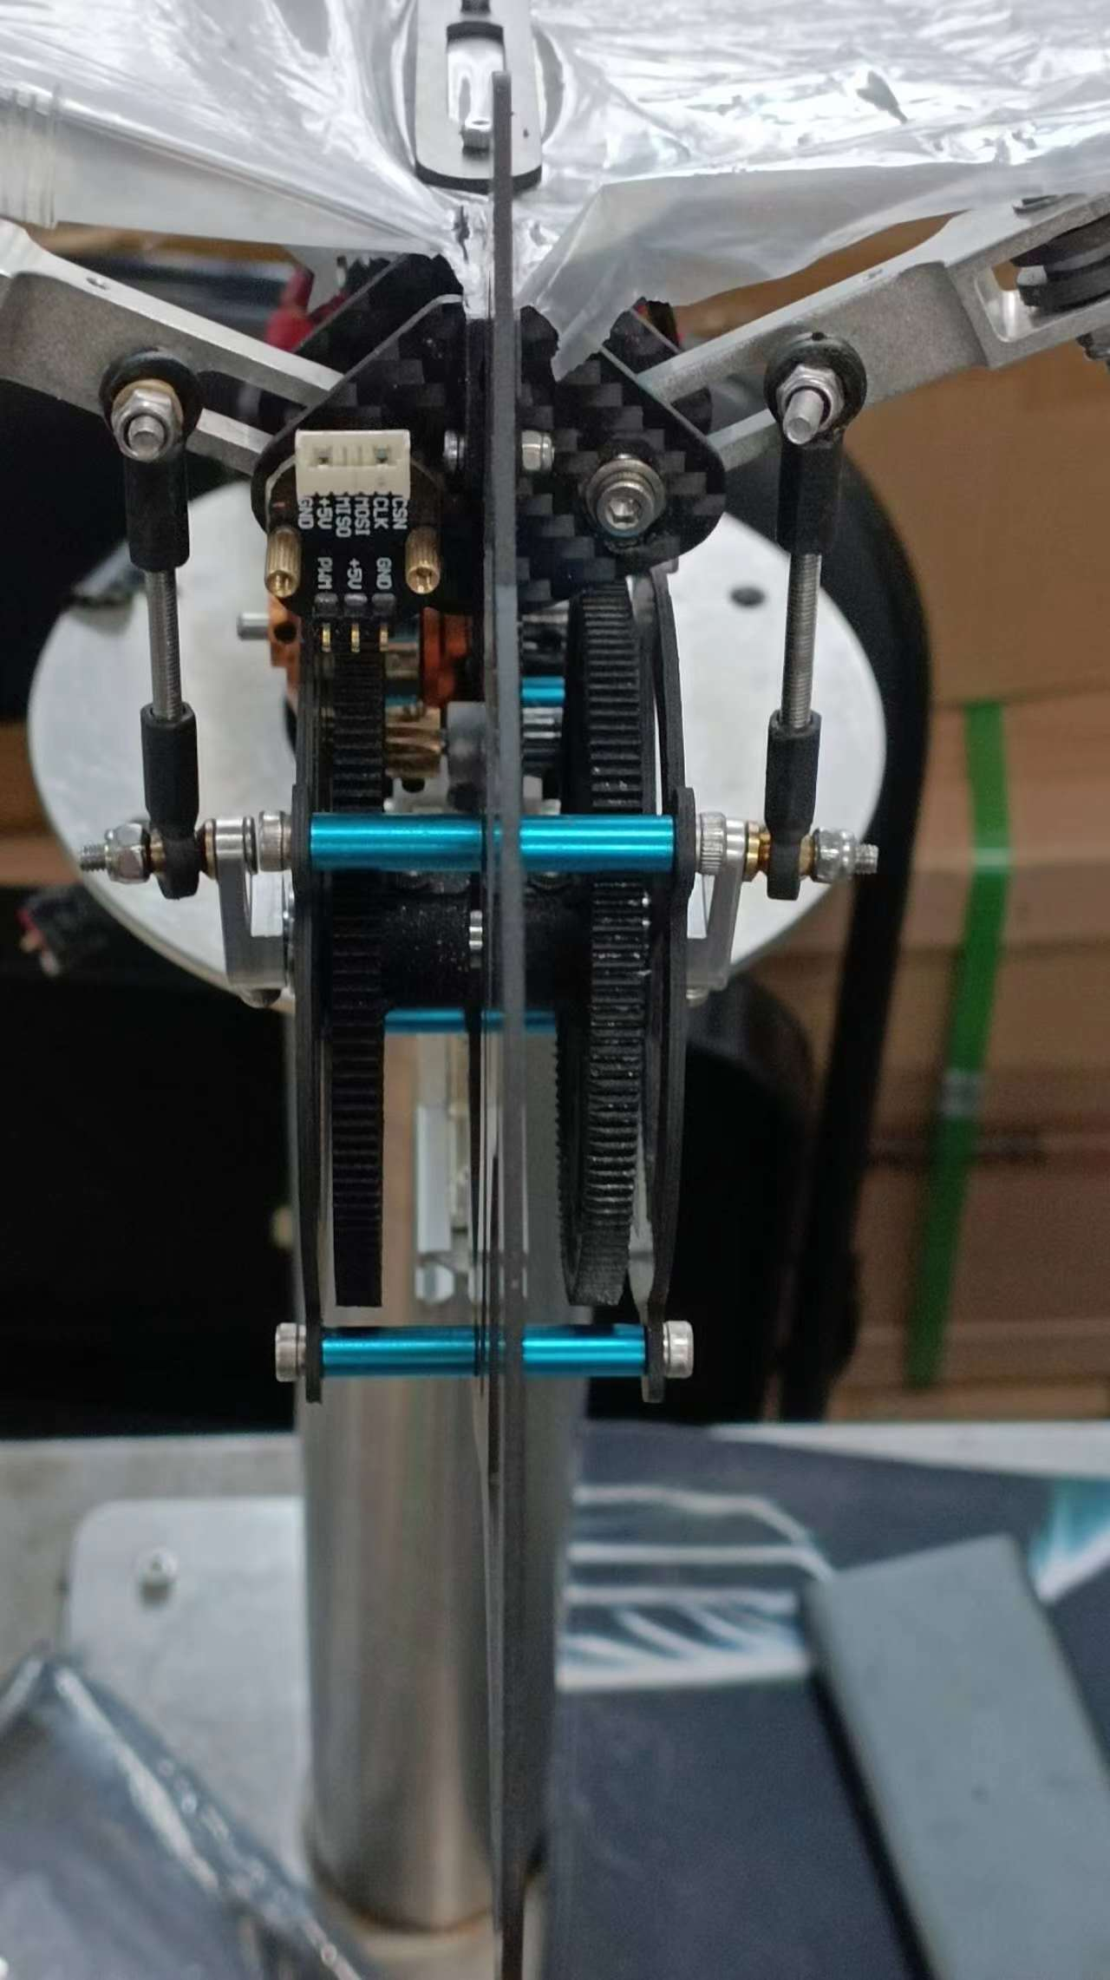
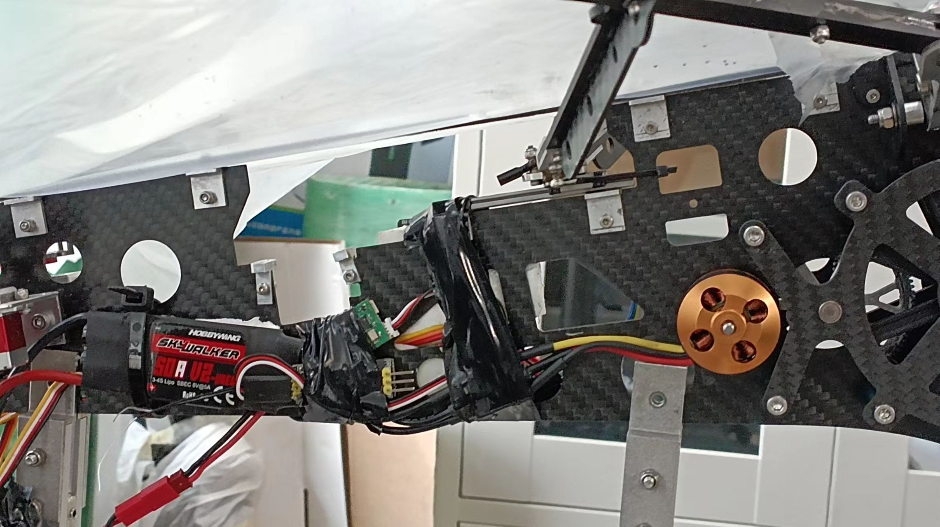
Batbot upgrade
UPGRADE
2 main gears
50 Amp Electronic Speed Controller
100 W DC Motor
Higher Flapping Amplitude
Page 8

Slide 12
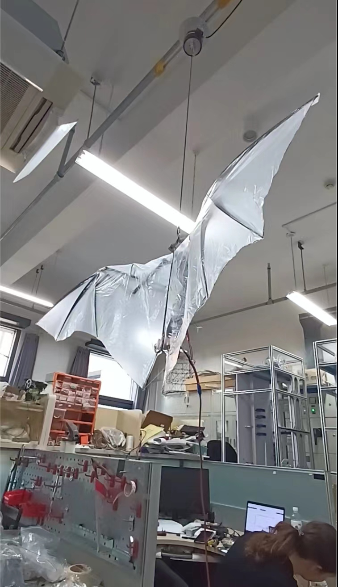
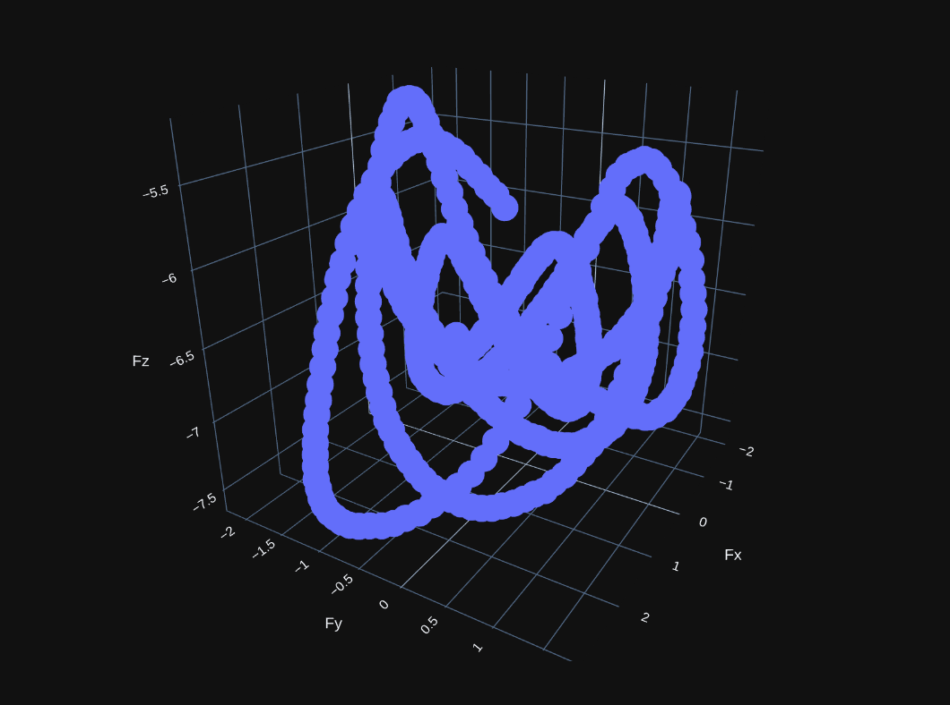
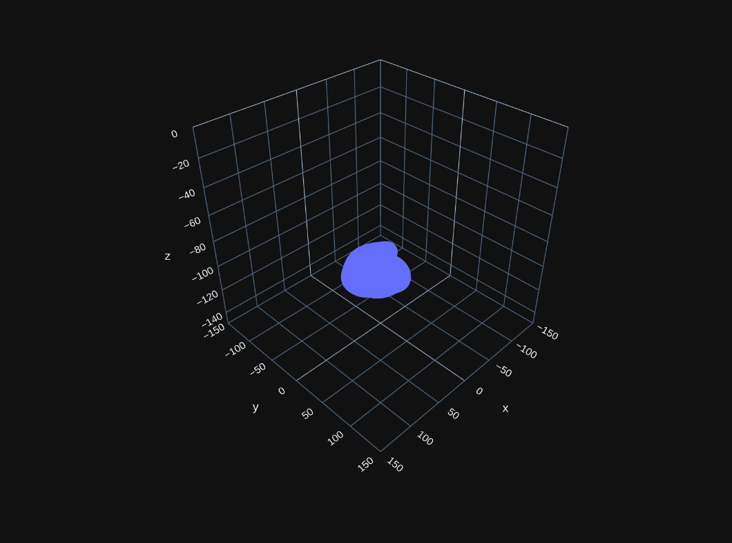
Dynamic Test-bench test
Safe multiple hovering tests
Realistic circumstances
Safe
If hovering, Batbot drawn to center, otherwise a force is measured.
With Hookes Law position known from force
Force
Page 9
Position

Slide 13
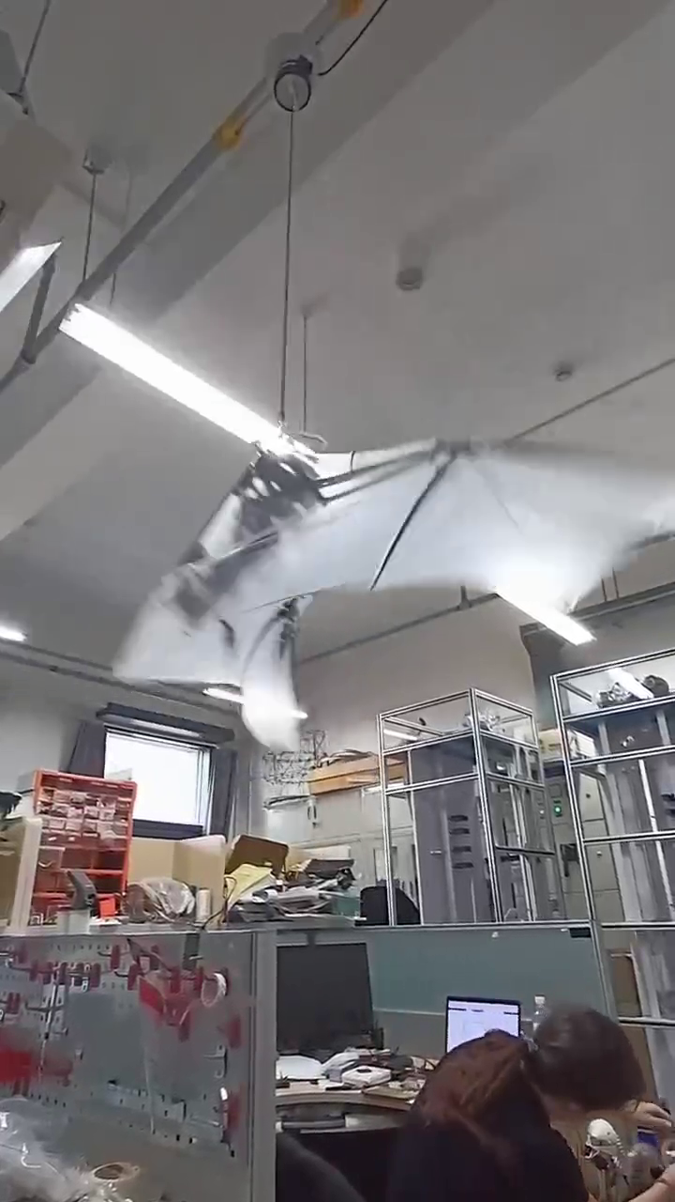
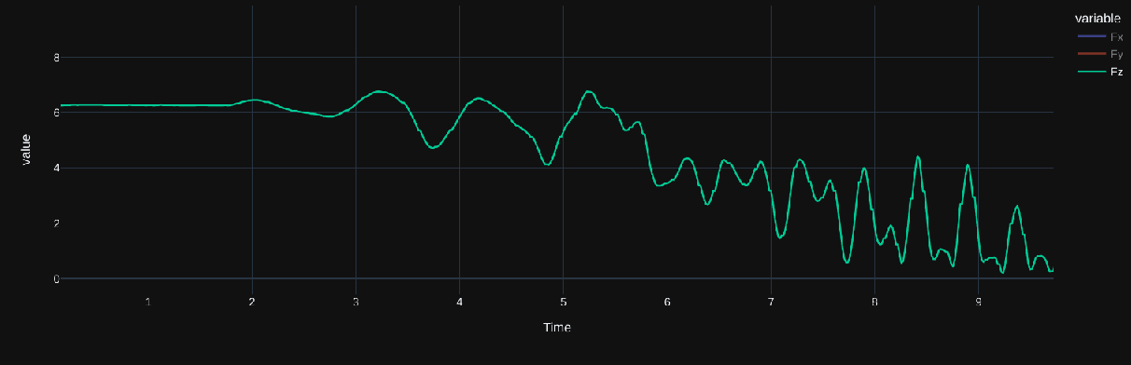
Dynamic test-bench results
Experiments Result: Upgraded version of Batbot is capable of generating enough lift to hover.
Page 10

Slide 14

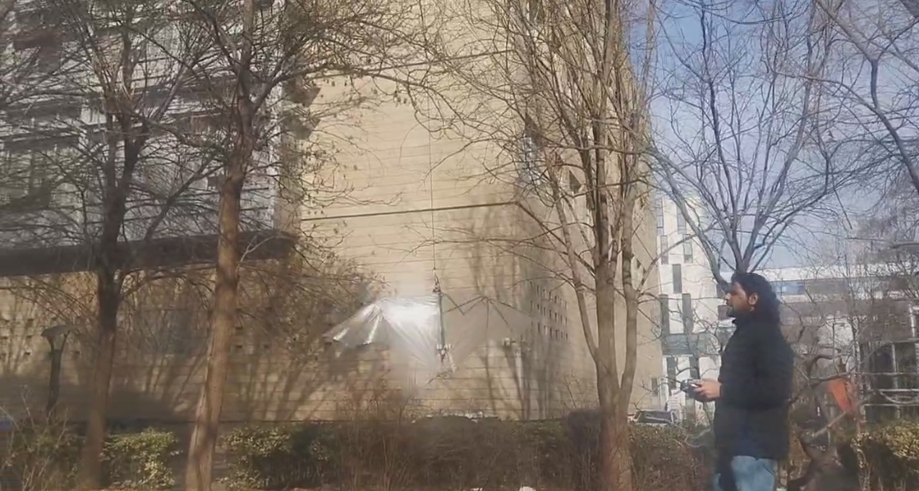
Outdoors experiments - Tied
Experiment Result: Batbot lifts and is relatively stable..

Slide 15
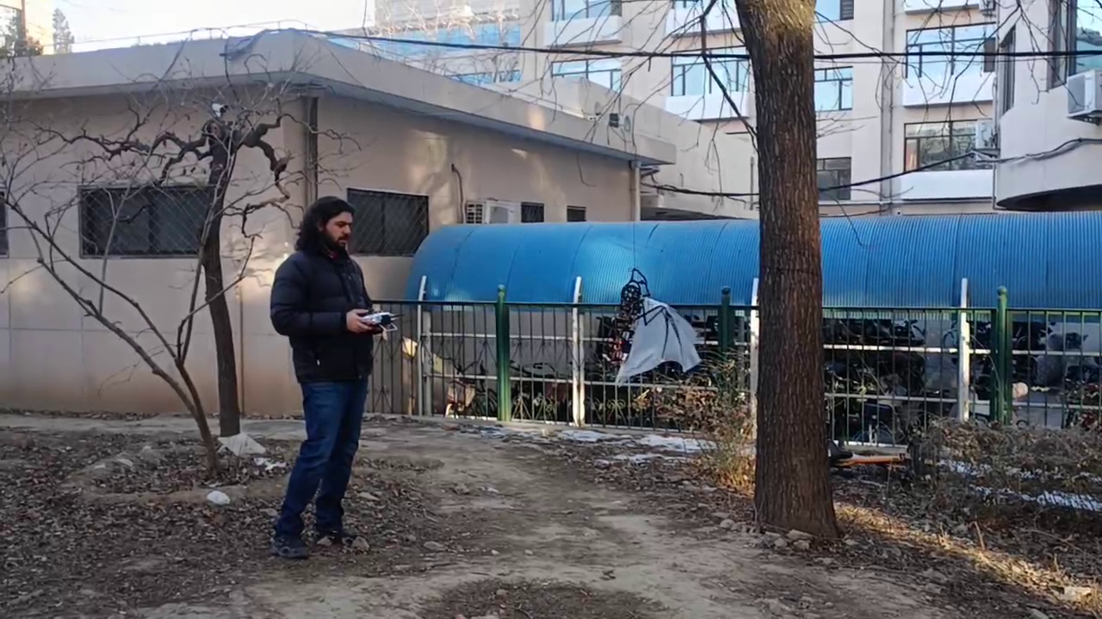
Outdoors experiments - Rotation
Experiment Result: It is possible to control to a certain degree the rotation of the Batbot mid-flight
Page 11

Slide 16
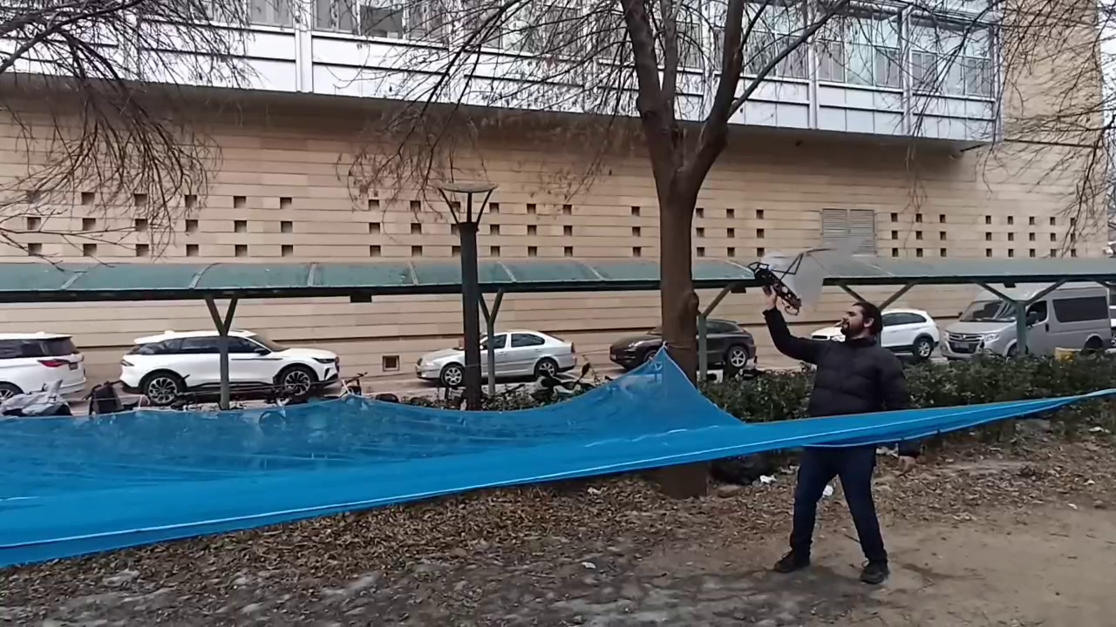
Outdoors experiments – free flight
Experiment Result: Initial free hand controlled hovering experiments as a starting point to be refined using the optimization algorithm.
Page 12

Slide 17
Final steps
Further experiment with hand controlled hovering to tackle remaining challenges and gain insight in hovering in real situation.
Applied gained information to the Evolutionary Algorithm optimization to refine controlling method.
Integrate accelerometer and gyroscope to attempt self sustained hovering.
Analyze if Evolutionary Algorithm can be used to train robots that are complex to simulate.
Page 13

Slide 18
Thank you for your attention!
More than happy to answer any question

